Slide 1
Chapter 2 Probability Distributions
Parametric approach
Specific functional form for the distribution.
Density estimation
Nonparametric approach
The form of the distribution typically depends on the size of the data set.
To model the probability distribution of a random variable, given a finite set of observations.
Frequentist: choose specific values for the parameters by optimizing some criterion, such as the likelihood function.
Bayesian: introduce prior distributions over the parameters and then use Bayes’ theorem to compute the corresponding posterior distribution given the observed data.

Slide 2
Chapter 2 Probability Distributions
2.1 Binary Variables
2.2 Multinomial Variables
2.3 The Gaussian Distribution
2.4 The Exponential Family
2.5 Nonparametric Methods
Kernel density estimators
Nearest-neighbour methods

Slide 3


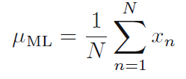
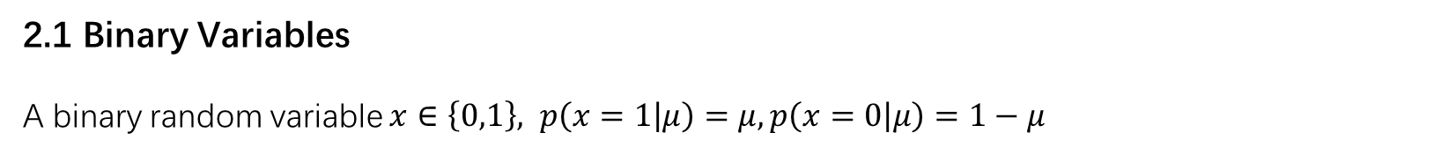
Chapter 2 Probability Distributions
2.1 Binary Variables
A binary random variable $x∈\left\{0,1\right\}, p\left(x=1 | μ\right)=μ, p\left(x=0 | μ\right)=1−μ$
The probability distribution over $x$
Mean and variance:
Maximum likelihood estimator:
(Frequentist way)
This can give severely over-fitted results for small data sets

Slide 4

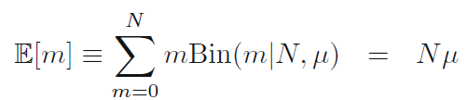

Chapter 2 Probability Distributions
2.1 Binary Variables
A binary random variable $x∈\left\{0,1\right\}, p\left(x=1 | μ\right)=μ, p\left(x=0 | μ\right)=1−μ$
The probability distribution over $x$
The distribution of the number $m$ of observations of $x=1$:

Slide 5

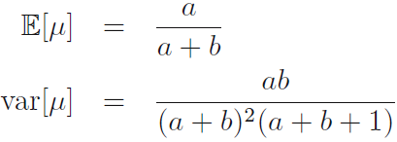

Chapter 2 Probability Distributions
2.1 Binary Variables
A binary random variable $x∈\left\{0,1\right\}, p\left(x=1 | μ\right)=μ, p\left(x=0 | μ\right)=1−μ$
The probability distribution over $x$
From the Bayesian perspective, we need to introduce a prior distribution $p(μ)$over the parameter $μ.$
Prior
Posterior

Slide 6


Chapter 2 Probability Distributions
2.1 Binary Variables
A binary random variable $x∈\left\{0,1\right\}, p\left(x=1 | μ\right)=μ, p\left(x=0 | μ\right)=1−μ$
The probability distribution over $x$
Predictive distribution:
$m, l −→+∞,$the Bayesian and maximum likelihood results will agree.

Slide 7


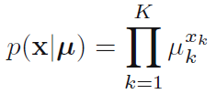
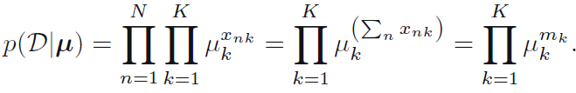
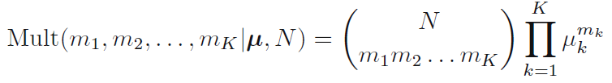




Chapter 2 Probability Distributions
2.2 Multinomial Variables
$$p\left(x_{k}=1\right)=μ_{k}$$
The distribution of $x$ is given:
$$=\{$$
$$\}$$
The joint distribution of the quantities $m_{1}, . . . , m_{K}$

Slide 8
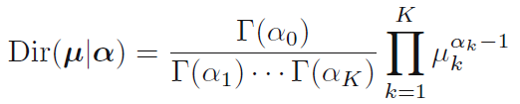
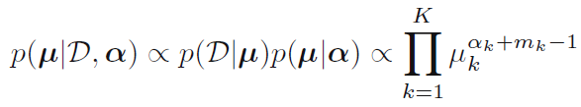
Chapter 2 Probability Distributions
2.2 Multinomial Variables
Introduce a family of prior distributions for the parameters $\{μ_{k}\}$ of the multinomial distribution.
Dirichlet distribution
Multiplying the prior by the likelihood function (2.34), we obtain the posterior distribution:
Dirichlet is indeed a conjugate prior for the multinomial.

Slide 9
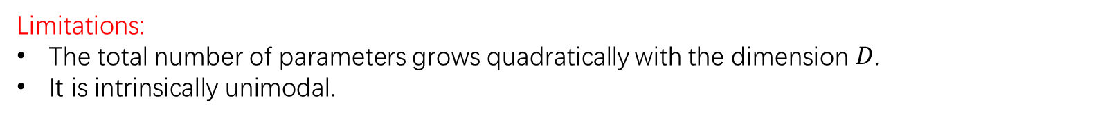
Chapter 2 Probability Distributions
2.3 The Gaussian Distribution
The multivariate Gaussian distribution takes the form
The author strongly encourages us to become proficient in manipulating Gaussian distributions using the techniques presented here as this will prove invaluable in understanding the more complex models presented in later chapters.
Limitations:
The total number of parameters grows quadratically with the dimension $D$.
It is intrinsically unimodal.

Slide 10
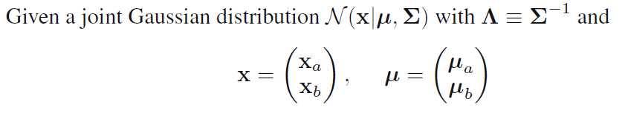
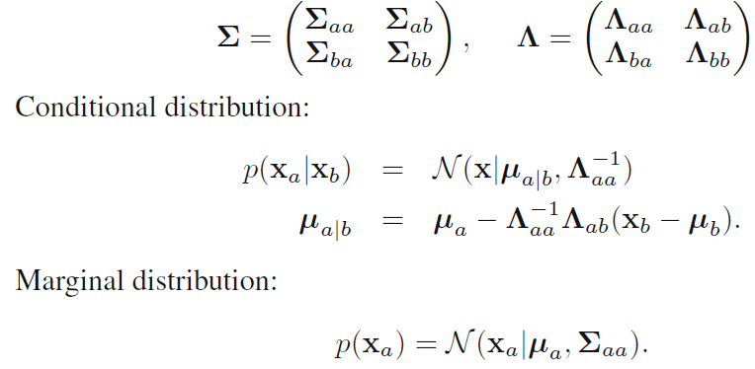

Chapter 2 Probability Distributions
2.3.1 Partitioned Gaussians
A linear function of

Slide 11

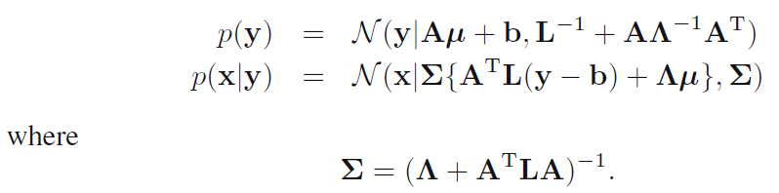
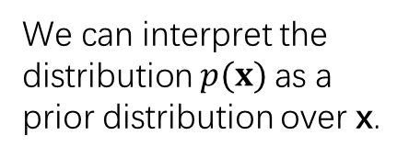
Chapter 2 Probability Distributions
2.3.3 Bayes’ theorem for Gaussian variables
Given a Gaussian marginal distribution p(x) and a Gaussian conditional distribution $p\left(y | x\right)$ which has a mean that is a linear function of x, and a covariance which is independent of x.
The evaluation of this conditional can be seen as an example of Bayes’ theorem.
We can interpret the distribution $p(x)$as a prior distribution over x.

Slide 12



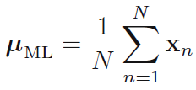

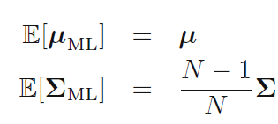

Chapter 2 Probability Distributions
2.3.4 Maximum likelihood for the Gaussian
Given a data set
The observations
are assumed to be drawn independently from a multivariate Gaussian distribution.

Slide 13
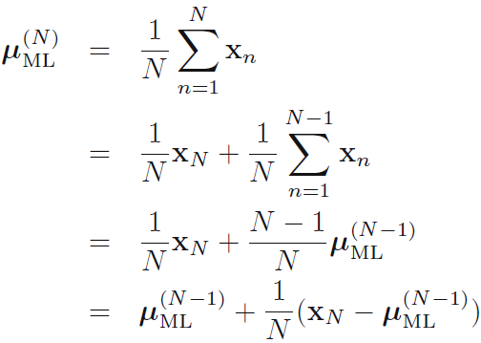

Chapter 2 Probability Distributions
2.3.5 Sequential estimation
Sequential methods allow data points to be processed one at a time and then discarded and are important for on-line applications, and also where large data sets are involved so that batch processing of all data points at once is infeasible.
However, we will not always be able to derive a sequential algorithm by this route, and so we seek a more general formulation of sequential learning.
Robbins-Monro procedure

Slide 14





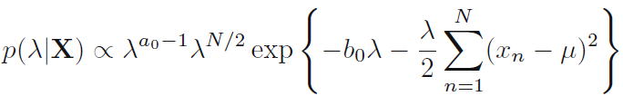
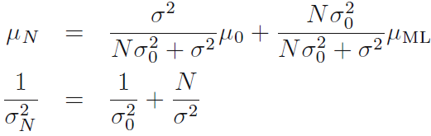

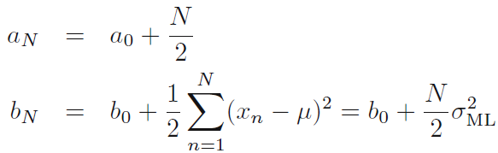
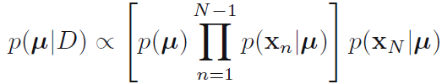
Chapter 2 Probability Distributions
2.3.6 Bayesian inference for the Gaussian
The variance $σ^{2}$ is known, the mean $μ$ is unknown.
The variance $σ^{2}$ is unknown, the mean $μ$ is known.
Prior
Posterior
A sequential update formula:
Both the mean and the precision are unknown,
normal-gamma

Slide 15









Chapter 2 Probability Distributions
2.3.7 Student’s $t$-distribution
This distribution in general has longer ‘tails’ than a Gaussian, which gives the $t$-distribution an important property called robustness.
Multivariate Student’s $t$-distribution:

Slide 16



Chapter 2 Probability Distributions
2.3.8 Periodic variables
von Mises distribution
circular normal
$θ_{0}$ is the mean of the distribution, $m$ is the concentration parameter.
zeroth-order Bessel modified function of the first kind

Slide 17


Chapter 2 Probability Distributions
2.3.9 Mixtures of Gaussians
as the prior probability of picking the $k^{th}$ component

Slide 18

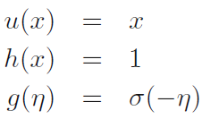
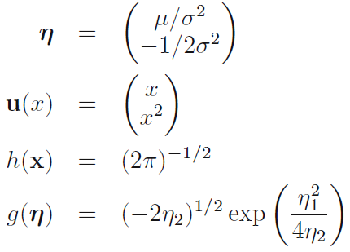
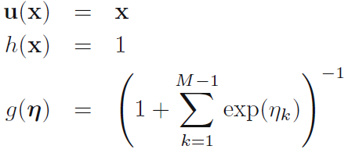
Chapter 2 Probability Distributions
2.4. The Exponential Family
Bernoulli distribution
Gaussian distribution
multinomial distribution

Slide 19

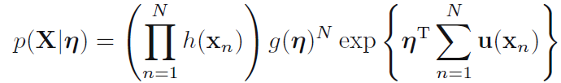

Chapter 2 Probability Distributions
2.4.1 Maximum likelihood and sufficient statistics
Maximum likelihood estimation for i.i.d. data
Setting the gradient of ln $p(X|η)$with respect to $η$ to zero
The only we need. sufficient statistic of exponential family.

Slide 20

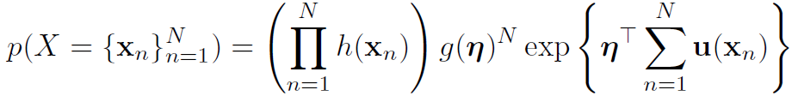
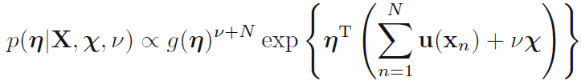
Chapter 2 Probability Distributions
2.4.2 Conjugate priors
Given a probability distribution $p(x|η)$, if the prior $p(η)$ is conjugate, the posterior has the same form as the prior.
All exponential family members have conjugate priors:
Combining the prior with a exponential family likelihood
we obtain

Slide 21






Chapter 2 Probability Distributions
2.5 Nonparametric methods
So far we have seen parametric densities in this chapter
Limitation: we are tied down to a specific functional form
Alternatively we can use (flexible) nonparametric methods
Basic idea: consider small region
with
For large $N$
we find about
For small R with volume$V$:
Thus, combining we find:

Slide 22


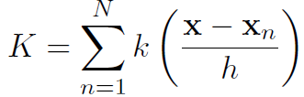


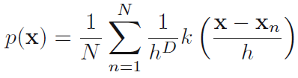
Chapter 2 Probability Distributions
2.5.1 Kernel density estimators：fix V , find K
Let the region be a unit hypercube around ,, with indicator:
Kernel function
# points in $X = \{x_{1}, . . . , x_{N}\}$ in hypercube of side $h$ is:
Plug this into approximation
, with

Slide 23





Chapter 2 Probability Distributions
2.5.2 Nearest-neighbour methods: fix K, find V
Single smoothing parameter for kernel approach is limiting
too large: structure is lost in high-density areas
too small: noisy estimates in low-density areas
we want density-dependent smoothing
Nearest Neighbor method also based on local approximation:
For new x, find the volume of the smallest circle centered on x enclosing $K$ points.
Nearest-neighbor methods: classification with Bayes rule
Density estimates from K-neighborhood with volume V :
Marginal density estimate
Class prior estimates:
Class-conditional estimate:
Posterior class probability from Bayes rule:

